Slide 1
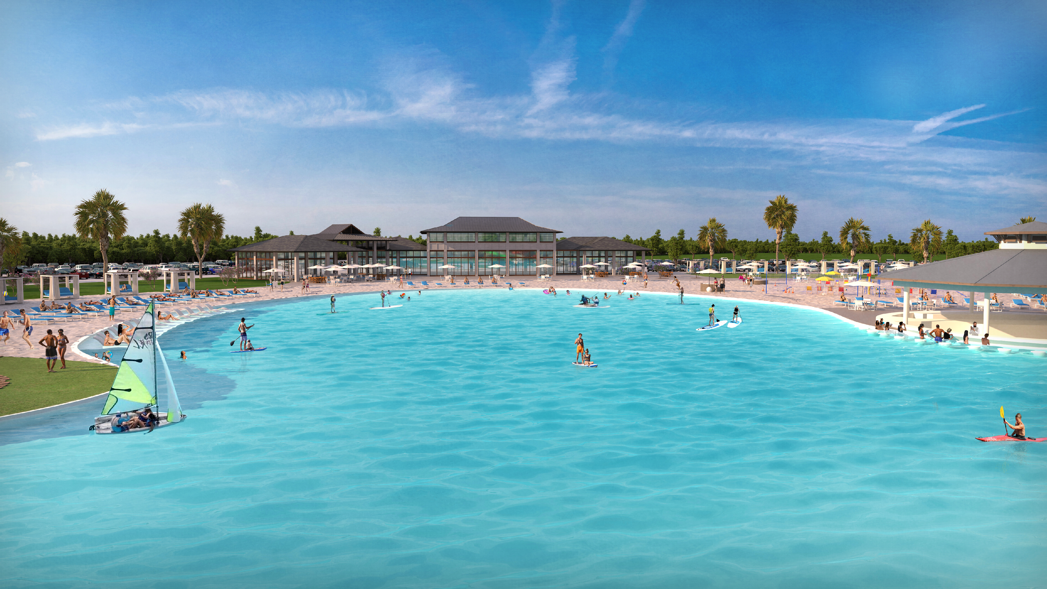

Laguna Azure
Resort Communities
WHO WE ARE

Slide 2
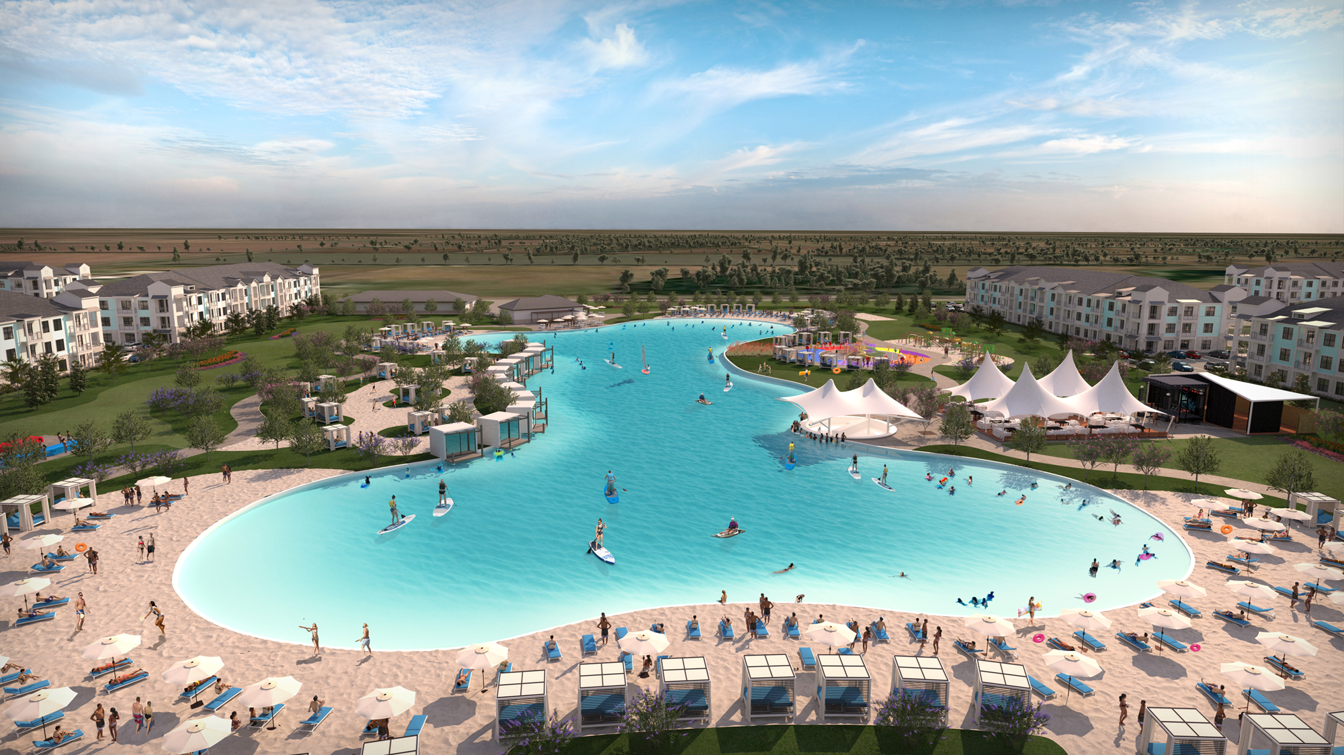
TRES RIOS LAGUNA AZURE
https://youtu.be/i0ByOPLQaFM

Slide 3
Presenting Tres Rios

Slide 5
Tres Rios

Slide 8
ENTERTAINMENT DISTRICT

Slide 9


Questions?

Slide 10
TRES RIOS

Slide 11
RESORT LIFESTYLE

Slide 12
RESORT LIFESTYLE

Slide 13
HIGH ACTION

Slide 14
ON THE WATER

Slide 15
CLASSES & PROGRAMING

Slide 17
LAGUNA AZURE SERVICE

Slide 18
DINING OPTIONS

Slide 19
FUN FOR ALL AGES

Slide 20
FUN FOR ALL AGES

Slide 21


